Slide 1
Increasing transparency through a multiverse analysis
Steegen, S., Tuerlinckx, F., Gelman, A., & Vanpaemel, W. (in press). Increasing
transparency through a multiverse analysis. Perspectives on Psychological Science.
NRIN Research Conference
may 25th 2016, Amsterdam
wolf vanpaemel university of leuven wolf.vanpaemel@kuleuven.be

Slide 2
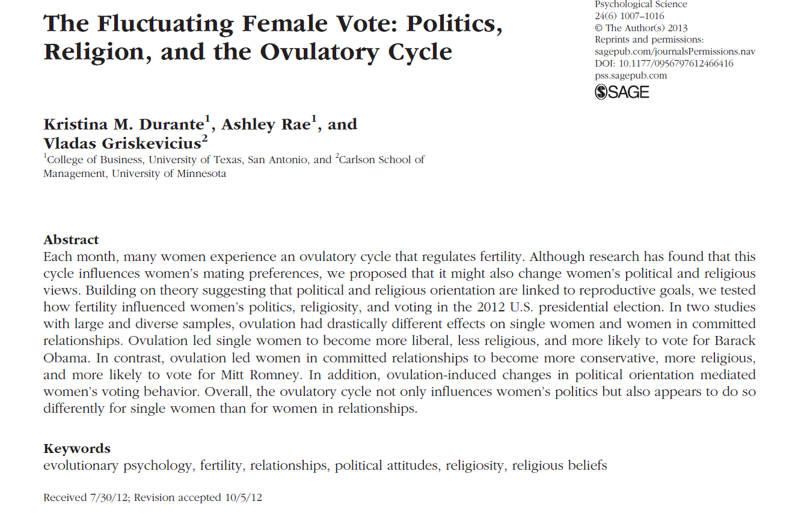

Slide 3
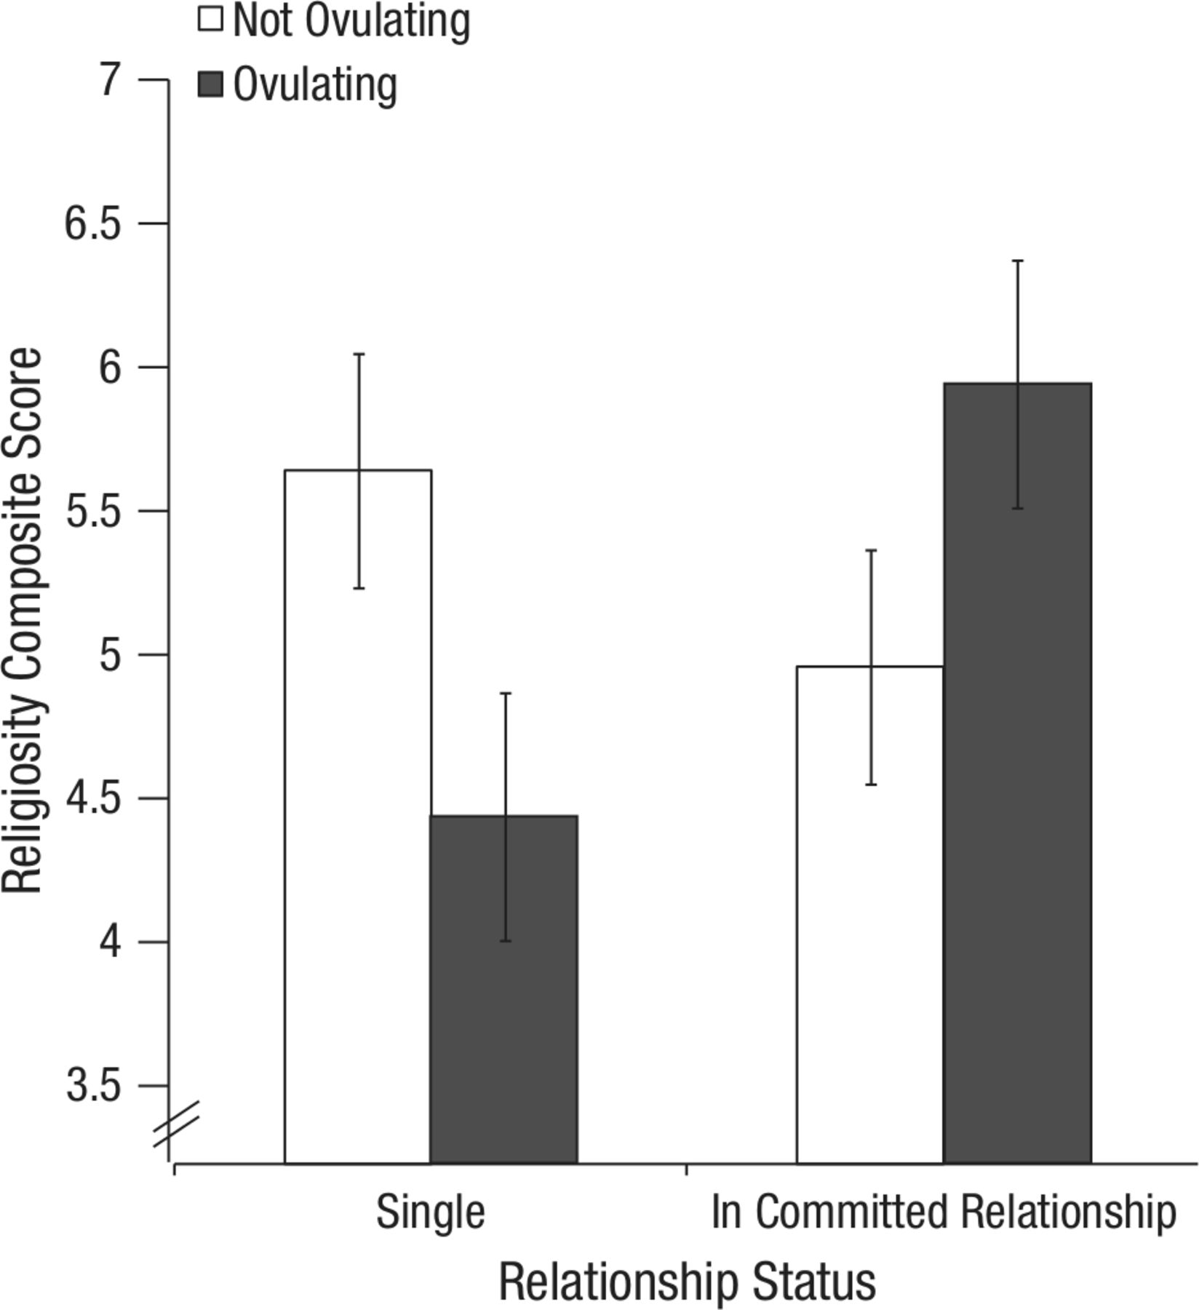
women’s religiosity as a function of fertility and relationship status
fertility x relationship status interaction,
F(1,159)=6.46, p=.012

Slide 4
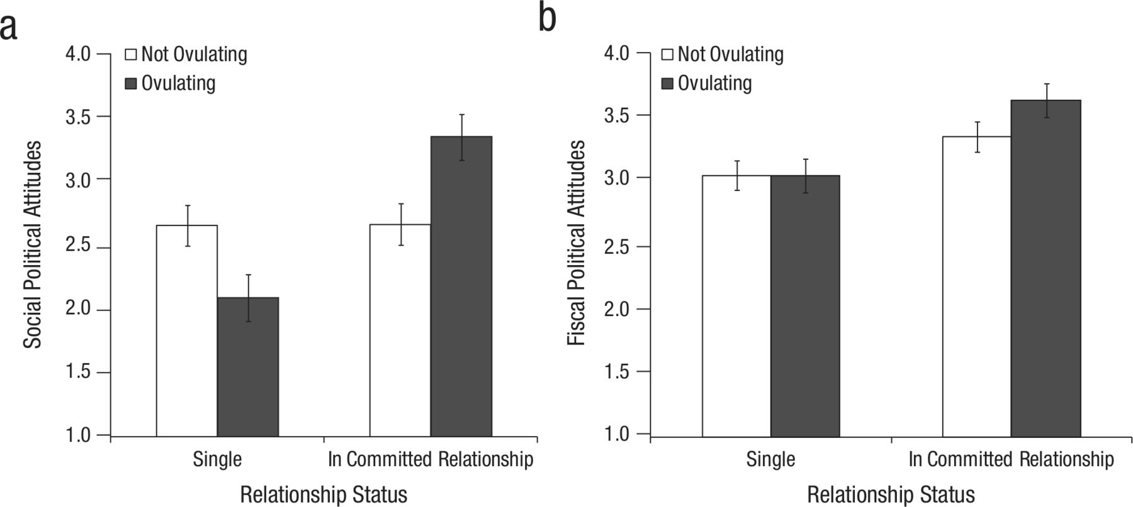
women’s social political attitudes (conservativism) as a function of fertility and relationship status
fertility x relationship status interaction, F(1,299)=12.26, p=.001

Slide 5
analyses are based on the following data
relationship status (single vs committed)
fertility status (high vs low)
religiosity score/social political attitudes score
these data were not just “collected” or “observed”
they were constructed

Slide 6
the observed, raw data include
answer to three statements on religiosity and five statements on social political attitudes (e.g., on abortion, marijuana, etc)
answer to “what is your current romantic relationship status?”
(1) not dating/romantically involved with anyone
(2) dating or involved with only one partner
(3) engaged or living with my partner
(4) married
answer to fertility related questions
the start of the last period
the start date of the period before the last period
the typical cycle length
the start of the next period
how sure are you about the start of the last period
how sure are you the start date of the period before the last period

Slide 7
the original single data set
translating the observed, raw data to the processed data ready for analysis involved several choices
relationship status?
answer to “what is your current romantic relationship status?”
(1) not dating/romantically involved with anyone
(2) dating or involved with only one partner
(3) engaged or living with my partner
(4) married
single
committed

Slide 8
translating the observed, raw data to the processed data ready for analysis involved several choices
fertility status?
answer to fertility related questions
the start of the last period
the start date of the period before the last period
the typical cycle length
the start of the next period
how sure are you about the start of the last period
how sure are you the start date of the period before the last period
high in fertility when cycle day is between 7 and 14
low in fertility when cycle day is between 17 and 25
cycle length →
next menstrual
onset → cycle day

Slide 9
translating the observed, raw data to the processed data ready for analysis involved several choices
who to include?
even women who are not sure about their start dates
even women who have irregular cycle lengths

Slide 10
other reasonable data sets
these choices seem reasonable
but other data construction choices are reasonable too
in data construction there are often many researcher degrees of freedom (simmons, nelson & simonsohn, 2011)

Slide 11
translating the observed, raw data to the processed data ready for analysis involved several choices
relationship status?
answer to “what is your current romantic relationship status?”
(1) not dating/romantically involved with anyone
(2) dating or involved with only one partner
(3) engaged or living with my partner
(4) married
single
committed

Slide 12
translating the observed, raw data to the processed data ready for analysis involved several choices
relationship status?
answer to “what is your current romantic relationship status?”
(1) not dating/romantically involved with anyone
(2) dating or involved with only one partner
(3) engaged or living with my partner
(4) married
single
committed

Slide 13
translating the observed, raw data to the processed data ready for analysis involved several choices
relationship status?
answer to “what is your current romantic relationship status?”
(1) not dating/romantically involved with anyone
(2) dating or involved with only one partner
(3) engaged or living with my partner
(4) married
single
committed

Slide 14
translating the observed, raw data to the processed data ready for analysis involved several choices
fertility status?
answer to fertility related questions
the start of the last period
the start date of the period before the last period
the typical cycle length
the start of the next period
how sure are you about the start of the last period
how sure are you the start date of the period before the last period
cycle length →
next menstrual
onset → cycle day

Slide 15
translating the observed, raw data to the processed data ready for analysis involved several choices
fertility status?
answer to fertility related questions
the start of the last period
the start date of the period before the last period
the typical cycle length
the start of the next period
how sure are you about the start of the last period
how sure are you the start date of the period before the last period
next menstrual
onset → cycle day

Slide 16
translating the observed, raw data to the processed data ready for analysis involved several choices
fertility status?
answer to fertility related questions
the start of the last period
the start date of the period before the last period
the typical cycle length
the start of the next period
how sure are you about the start of the last period
how sure are you the start date of the period before the last period
cycle day

Slide 17
translating the observed, raw data to the processed data ready for analysis involved several choices
fertility status?
answer to fertility related questions
the start of the last period
the start date of the period before the last period
the typical cycle length
the start of the next period
how sure are you about the start of the last period
how sure are you the start date of the period before the last period
high in fertility when cycle day is between 7 and 14
low in fertility when cycle day is between 17 and 25
cycle length →
next menstrual
onset → cycle day

Slide 18
translating the observed, raw data to the processed data ready for analysis involved several choices
fertility status?
answer to fertility related questions
the start of the last period
the start date of the period before the last period
the typical cycle length
the start of the next period
how sure are you about the start of the last period
how sure are you the start date of the period before the last period
high in fertility when cycle day is between 6 and 14
low in fertility when cycle day is between 17 and 27
durante et al., 2011
cycle length →
next menstrual
onset → cycle day

Slide 19
translating the observed, raw data to the processed data ready for analysis involved several choices
fertility status?
answer to fertility related questions
the start of the last period
the start date of the period before the last period
the typical cycle length
the start of the next period
how sure are you about the start of the last period
how sure are you the start date of the period before the last period
high in fertility when cycle day is between 9 and 17
low in fertility when cycle day is between 18 and 25
durante et al., 2012
cycle length →
next menstrual
onset → cycle day

Slide 20
translating the observed, raw data to the processed data ready for analysis involved several choices
who to include?
only women who are reasonably sure about their start dates
only women who have regular cycle lengths
the estimated cycle length
the reported cycle length

Slide 21
relationship status assessment (3 choice options)
cycle day assessment (3 choice options)
fertility assessment (5 choice options)
exclusion criteria based on cycle length (3 choice options)
exclusion criteria based on certainty (2 choice options)
all choices have been used in other studies and seem reasonable
each combination of choices gives rise to a separate data set
>100 reasonable data sets in this example

Slide 22
into the multiverse
the raw data
do not uniquely give rise to a single data set
give rise to a multiverse of data sets, by (consistent) combination of all reasonable choices
excluding inconsistent combinations
e.g., if reported cycle length is used in cycle day assessment, estimated cycle length is not used as an exclusion criterion
each data set from this multiverse gives rise to a statistical result on the effect of fertility
there is a multiverse of statistical results

Slide 23
if the choices made for constructing the single data set are arbitrary, the single statistical result is arbitrary
arbitrary?
lacking clear motivation/justification
ambiguous
inconsistent with related studies
by reporting a N=1 sample from the data multiverse, the arbitrariness of the statistical result is hidden

Slide 24
obvious solution:
don’t just report a single statistical result if this is arbitrary
repeat the analysis of interest for each possible combination of choices (i.e., across the multiverse of data sets)
a multiverse analysis
provides a detailed picture of the robustness or fragility of statistical results
helps identifying key choices that conclusions hinge on

Slide 25
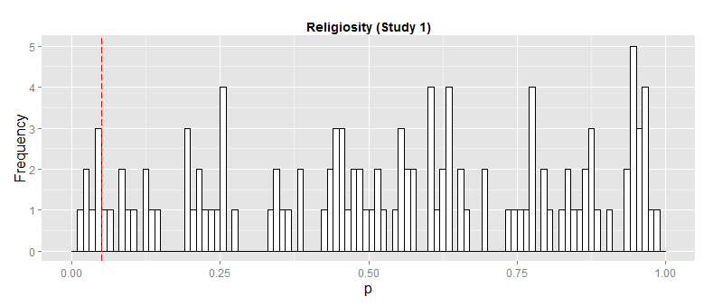
effect is too fragile to be taken seriously
6%

Slide 26
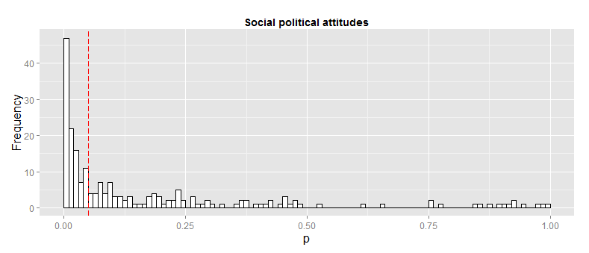
49%
your belief in the effect heavily depends on
your belief in the different processing choices

Slide 27
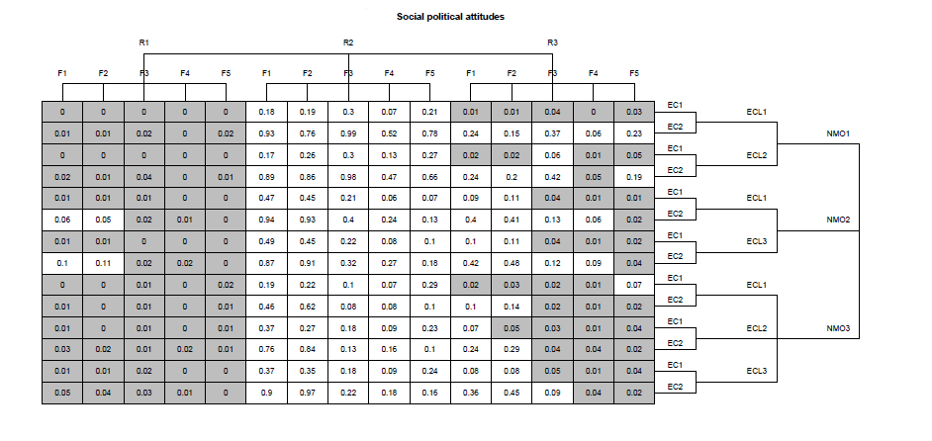
if you trust R1, there is a significant effect of fertility
if you trust R2, there is no significant effect of fertility
if you have no reason to prefer certain choices
you are uncertain about the effect of fertility
your main conclusion should be a methodological one: the need to deflate the multiverse

Slide 28
deflating the multiverse
better theory on the relationship between cycle day and fertility
different way of assessing fertility
surges in luteinizing hormone (e.g., durante et al., 2011)
cleaner design in assessing relationship status
dating or involved with only one partner is too ambiguous to be helpful

Slide 29
a multiverse analysis
shows the robustness or fragility of a finding
helps identifying the sources of the fragility
is not restricted to p-values alone
e.g., Bayes factors are equally sensitive to choices in data construction
is also informative when an analysis is pre-registered or done blindly
requires access to the raw data, not the processed data (thank you kristina durante!)
shows a small part only of a larger multiverse of statistical results
there is not only a data multiverse but also a model multiverse (e.g., patel, burford, and ioannidis, 2015)

Slide 30
conclusion
data sets are often constructed rather than collected
data construction is often arbitrary
the statistical result is as arbitrary as the data construction
reporting a single data set analysis can be misleading
we should both reduce and report the multiverse of statistical results

Slide 31
references
Durante, K. M., Griskevicius, V., Hill, S. E., Perilloux, C., & Li, N. P. (2011). Ovulation, female competition, and product choice: Hormonal influences on consumer behavior. Journal of Consumer Research, 37 , 921–934.
Durante, K. M., Griskevicius, V., Simpson, J. A., Cantú, S. M., & Li, N. P. (2012). Ovulation leads women to perceive sexy cads as good dads. Journal of Personality and Social Psychology, 103 , 292–305.
Durante, K. M., Rae, A., & Griskevicius, V. (2013). The fluctuating female vote: Politics, religion, and the ovulatory cycle. Psychological Science, 24 , 1007–1016.
Patel, C. J., Burford, B., & Ioannidis, J. P. (2015). Assessment of vibration of effects due to model specification can demonstrate the instability of observational associations. Journal of Clinical Epidemiology, 68 (9), 1046–1058.
Simmons, J. P., Nelson, L. D., & Simonsohn, U. (2011). False-positive psychology: Undisclosed flexibility in data collection and analysis allows presenting anything as significant. Psychological Science, 22 , 1359–1366.

Slide 32
Increasing transparency through a multiverse analysis
Steegen, S., Tuerlinckx, F., Gelman, A., & Vanpaemel, W. (in press). Increasing
transparency through a multiverse analysis. Perspectives on Psychological Science.
NRIN Research Conference
may 25th 2016, Amsterdam
wolf vanpaemel university of leuven wolf.vanpaemel@kuleuven.be

